Slide 1
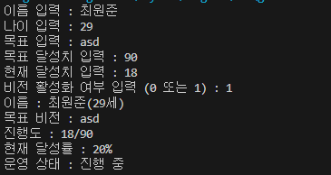
#include <iostream>
#include <string>
using namespace std;
int main(void)
{
string strName = "";
int nAge = 0;
string strTarget = "";
int nMaxTargetRatio = 0;
int nCurrentTargetRatio = 0;
bool bActive = false;
float fTargetRatio = 0.0f;
cout << "이름 입력 : ";
cin >> strName;
cout << "나이 입력 : ";
cin >> nAge;
cout << "목표 입력 : ";
cin >> strTarget;
cout << "목표 달성치 입력 : ";
cin >> nMaxTargetRatio;
cout << "현재 달성치 입력 : ";
cin >> nCurrentTargetRatio;
cout << "비전 활성화 여부 입력 (0 또는 1) : ";
cin >> bActive;
fTargetRatio = (float)nCurrentTargetRatio / (float)nMaxTargetRatio * 100.0f;
cout << "이름 : " << strName << "(" << nAge << "세)" << endl;
cout << "목표 비전 : " << strTarget << endl;
cout << "진행도 : " << nCurrentTargetRatio << "/" << nMaxTargetRatio << endl;
cout << "현재 달성률 : "<< fTargetRatio << "%" << endl;
cout << "운영 상태 : " << (bActive ? "진행 중" : "준비 중") << endl;
return 0;
}

